Slide 1


PREDICTION OF FOREST COVER TYPE
PROJECT FINAL PRESENTATION
Batch: DSE_BANGALORE_AUG2019
Mentor: Mr. Ankush Bansal
SUBMITTED BY:
PRASHANTH G
AMULYA MANNE
APOORVA
GANESH DARSHAN

Slide 2
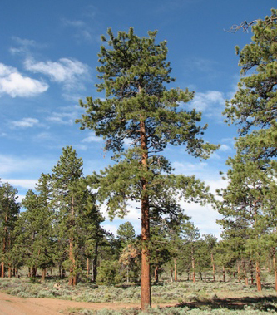
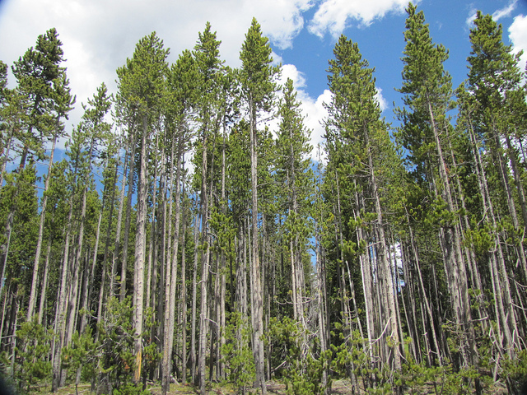
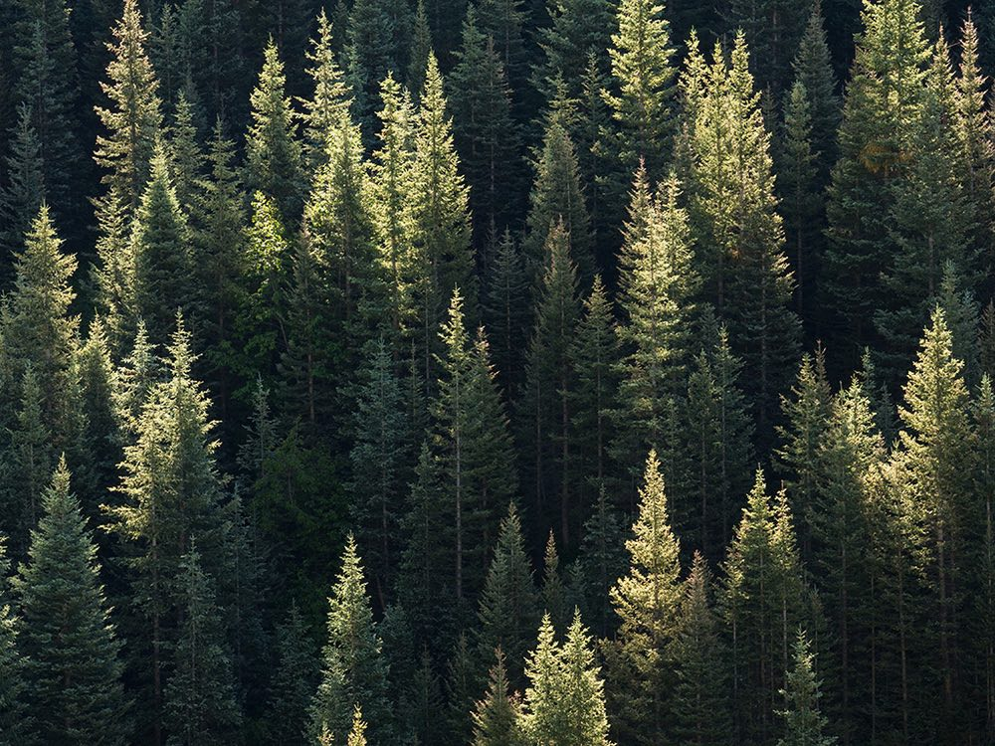
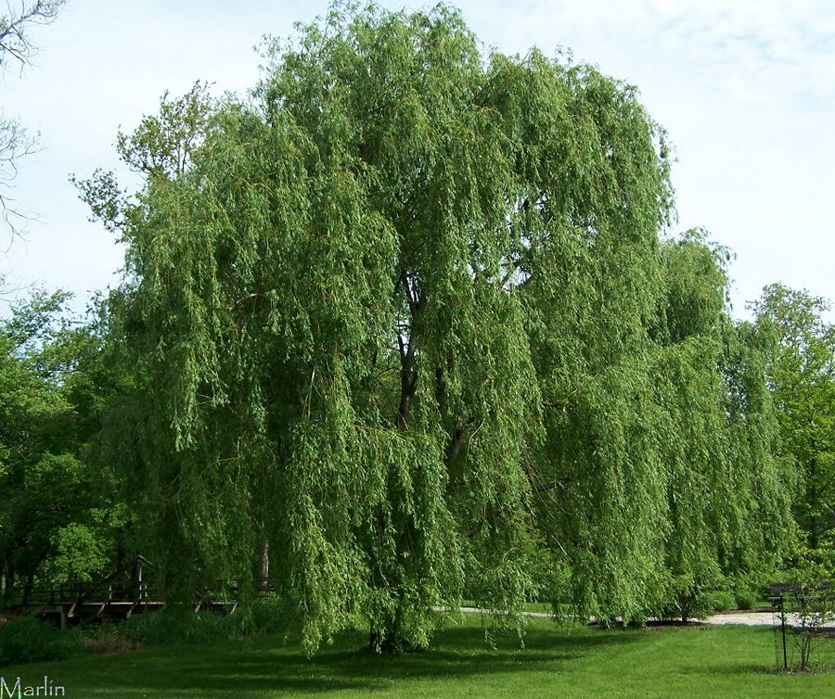
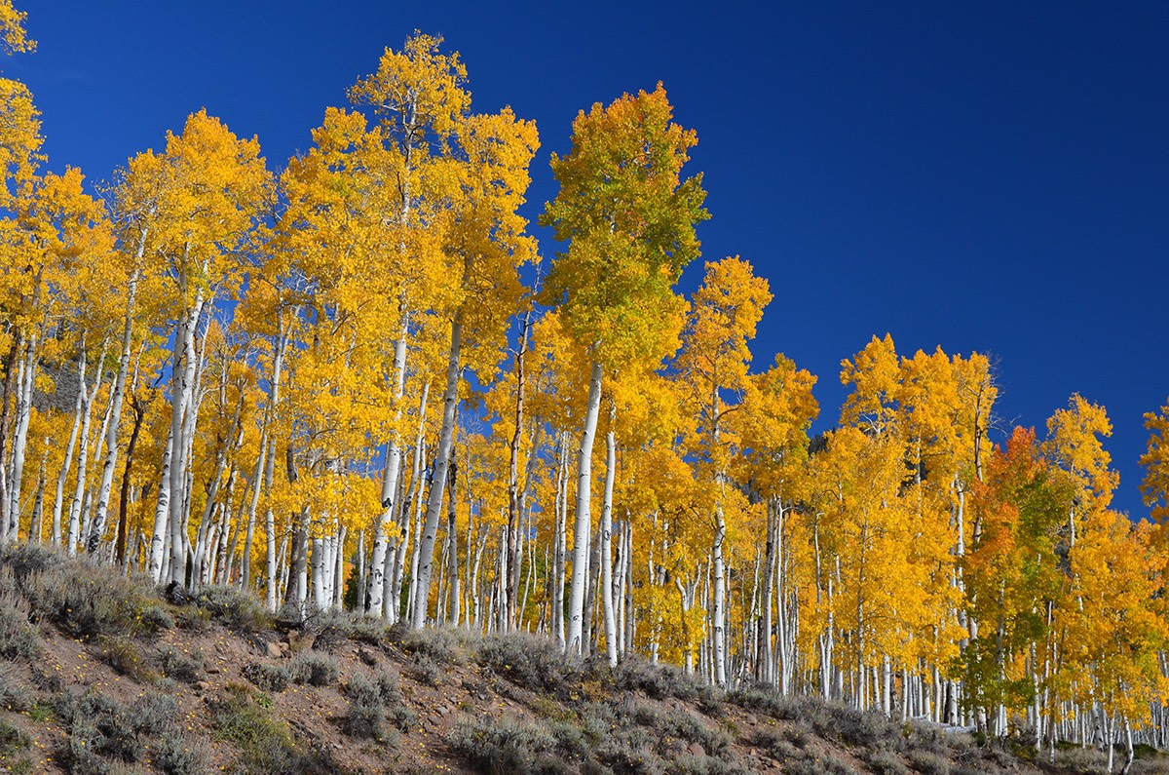
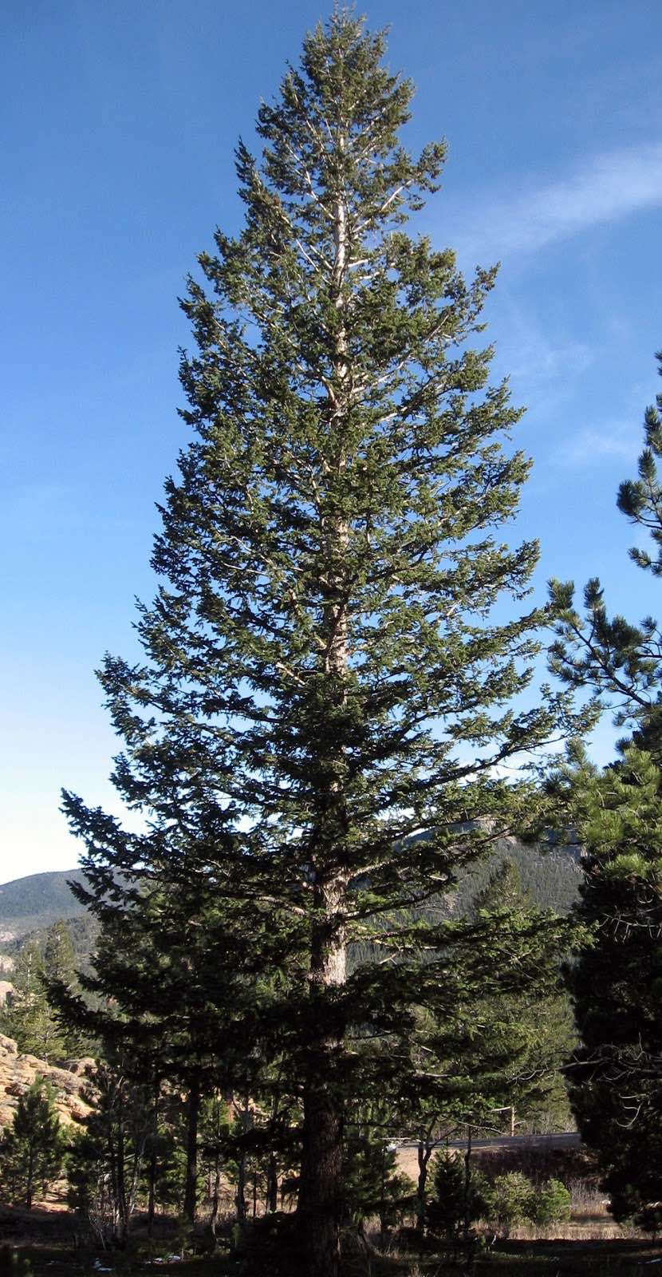
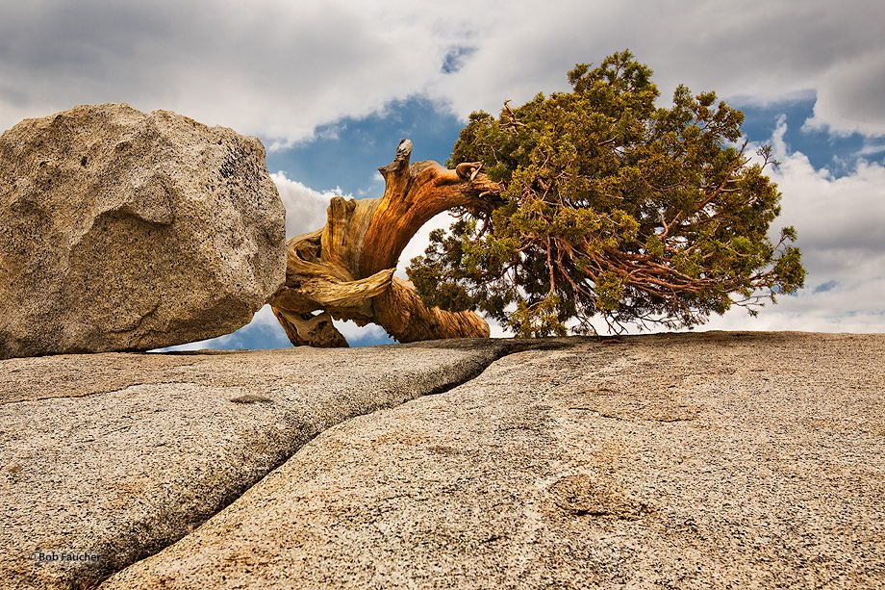
Business mission
Stakeholders: Natural resource managers
Use Case: Ecological Development, asset management and cover
Predicting The Forest Cover Type.
Providing insights or recommendations through EDA.
improve the current prediction efficiency from 70.58%.
Data Source: https://archive.ics.uci.edu/ml/datasets/covertype

Slide 3
Attribute Information
Elevation | Continuous | Elevation in meters
Aspect | Continuous | Aspect in degrees azimuth
Slope | Continuous | Slope in degrees
Horizontal_Distance_To_Hydrology | Continuous | Horizontal dist. to nearest surface water features
Vertical_Distance_To_Hydrology | Continuous | Vertical dist. to nearest surface water features
Horizontal_Distance_To_Roadways | Continuous | Horizontal dist to nearest roadway
Hillshade_9am | Continuous (0 to 225) | Hillshade index at 9am
Hillshade_Noon | Continuous (0 to 225) | Hillshade index at noon
Hillshade_3pm | Continuous (0 to 225) | Hillshade index at 3pm
Horizontal_Distance_To_Fire_Point | Continuous | Slope in degrees
Wilderness_Area (4 binary columns) | Categorical | Wilderness area designation
Soil_Type (40 binary columns) | Categorical | Soil Type designation
Cover_Type (7 types) | Categorical | Forest Cover Type designation

Slide 4
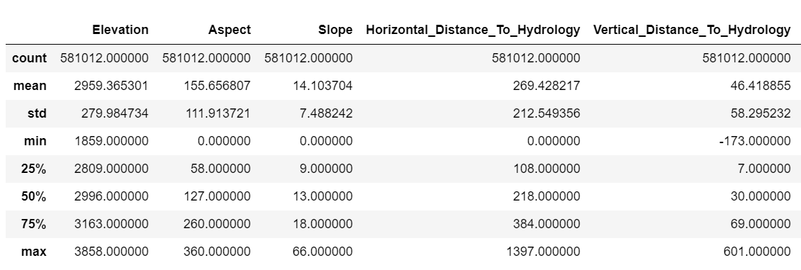
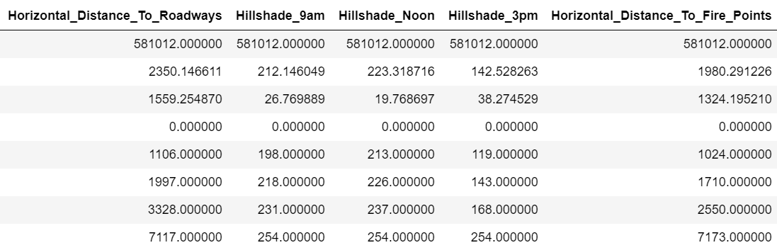
EDA- Data Statistical Description

Slide 5

Feature Engineering
Creation of synergy variables:
In the given dataset to ensure that the fields are cleaned,necessary Synergy variables are created
Hence the number of columns are reduced from 55 to 23.
Variable Name | Variables used | Method
Distance_To_Hydrology | ‘Horizontal distance to hydrology’ ‘Vertical distance to hydrology’ | Created an Hypotenuse to the Hydrology by a^2+b^2=c^2
Hillshade | Hillshade_9am Hillshade_Noon Hillshade_3pm | Took the mean of the columns.
CG_Zone(11 Variables) | 40 Soil types | Reversed the Dummies and re-created the Dummies by using the first 2 digits of ELU code

Slide 6
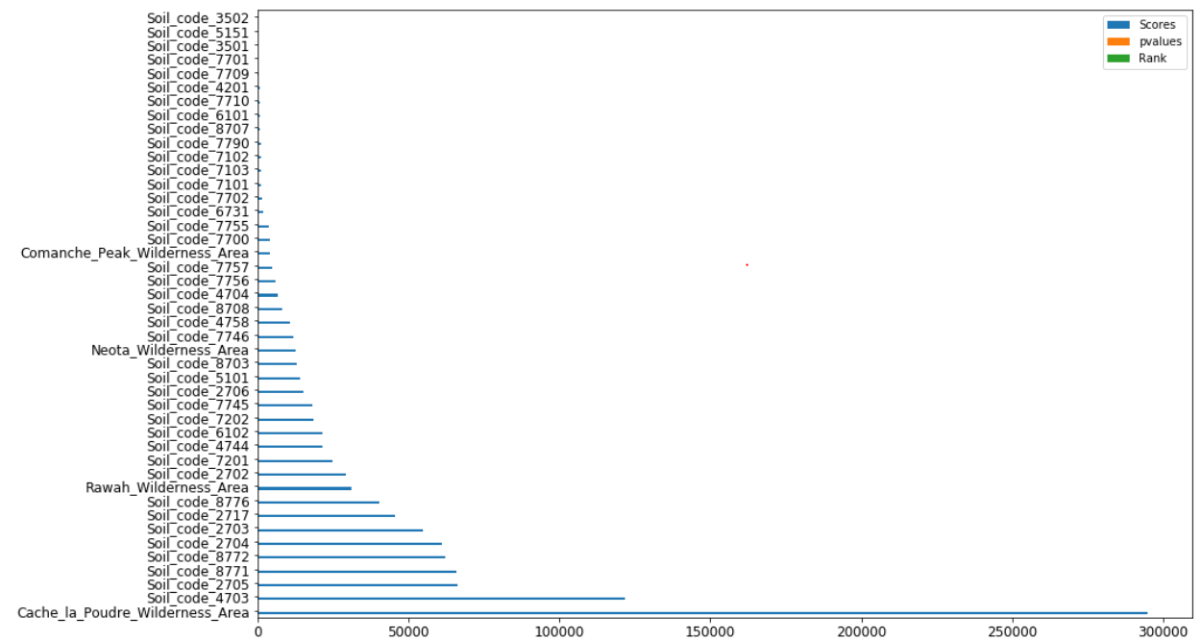
Statistical test Chi2
Form the above graph it is clear that the top 5 features contributing to the Target cover type is Cache_la, soil_code_4703,soil_code_2705,soil_code_8771,soil_code_2704

Slide 7
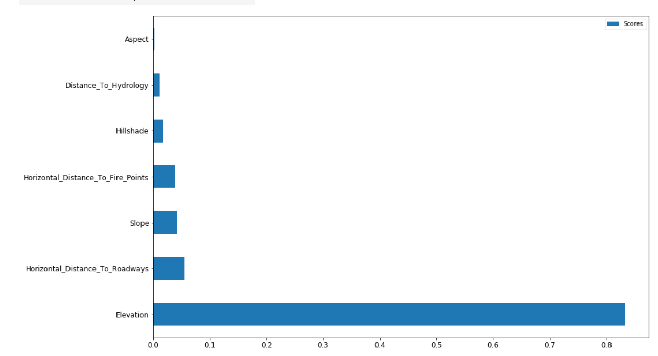
Statistical Test Anova (Selectkbest)
From the Above graph we can see that the top 3 features that contribute for Cover Type are Elevation, Horizontal_Distance_To_Roadways and Slope.

Slide 8
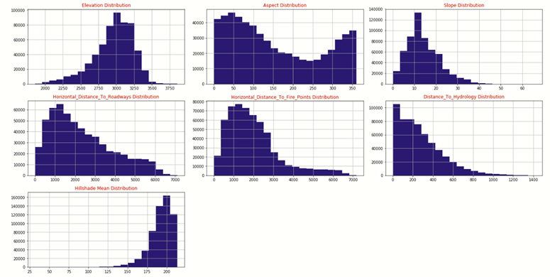
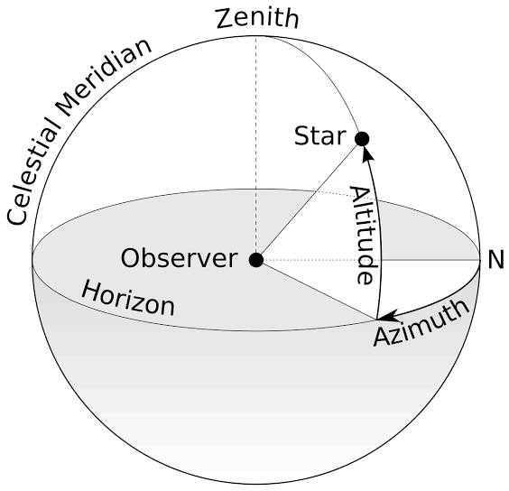
Visualization-Univariate Analysis
From the above we can see that most of the distribution is Right Skewed(Mode<Median<mean) and Aspect has 2 peeks one at zero and 360.

Slide 9
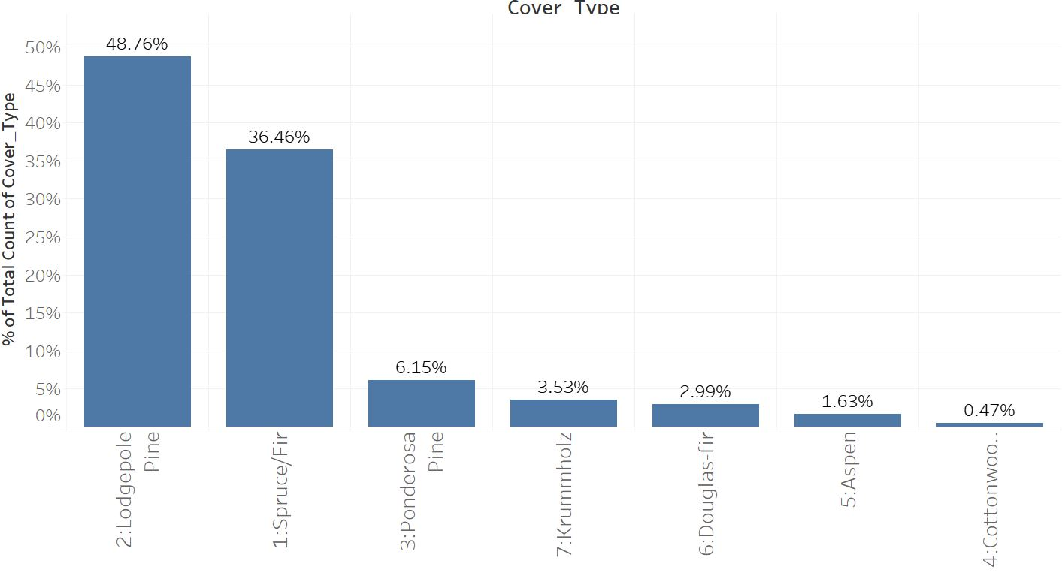
Visualization-Univariate Analysis
Distribution of Cover Type(Target)
The Lodgepole pine and Spruce/Fir accounts to 85% of cover type and cottonwood/willow has the least area.

Slide 10
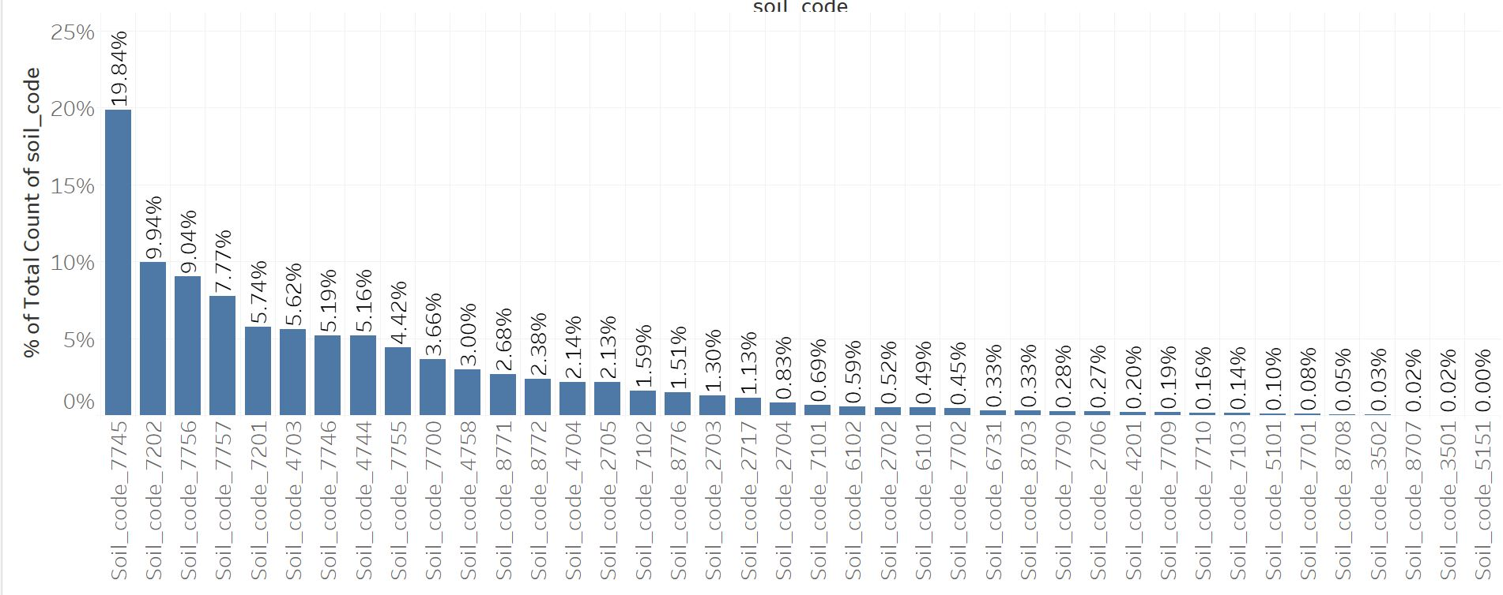
Visualization-Univariate Analysis
Soil Distribution
Soil Code_7745,7202,7756 combined accounts to 38.87% of Soils and the Scarce Soil in this list is 5151<(0.004%).

Slide 11
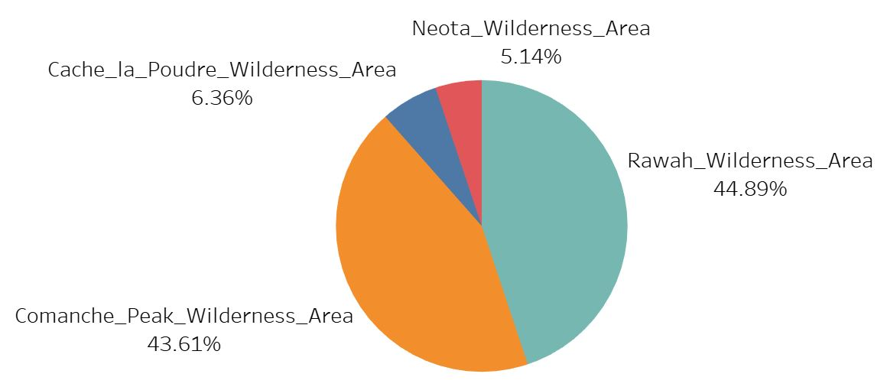
Visualization-Univariate Analysis
We can see that the Rawah Area has the highest presence and Nota area has the least presence.

Slide 12
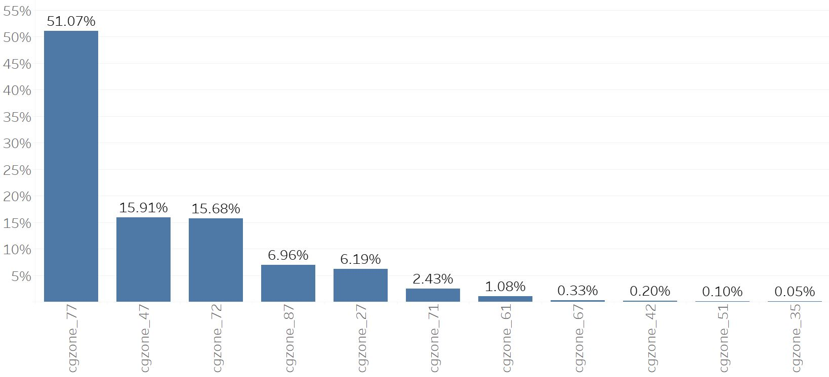
Visualization-Univariate Analysis
CG_zone (77,47,72) combined accounts to 82.66% of CG_zone and the last 4 CG_zone(67,42,51,35) combined has 0.68%

Slide 13
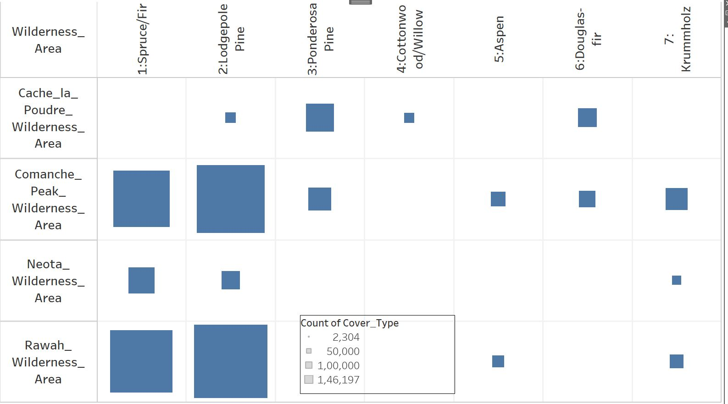
Visualization-Bivariate Analysis
From the above We can see that Cottonwood is only found in Cache_la.
The diversity of Cover type in Comanche_peak is high.
The Density of unique Cover type in Cache_la is high.

Slide 14
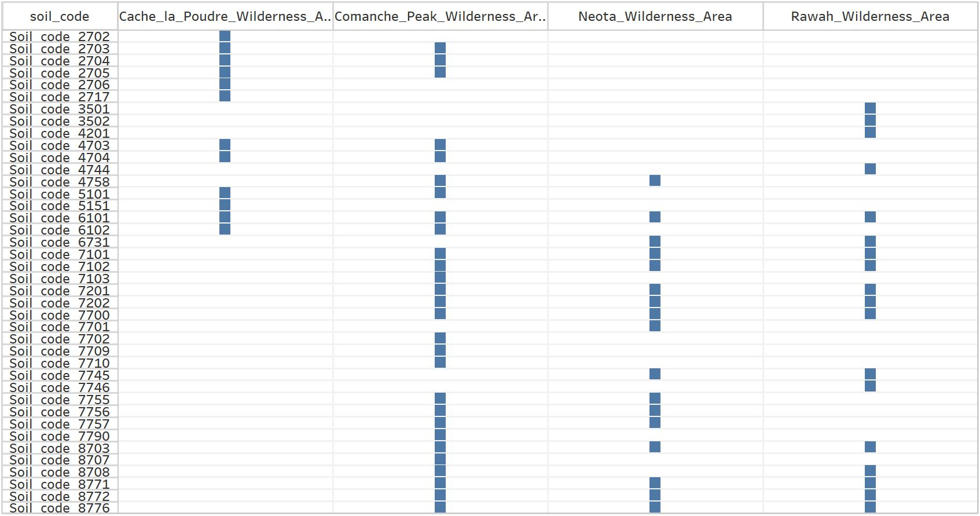
Visualization-Bivariate Analysis
Here Also We see that the Diversity of soil in Comanche_peak is high. That’s why even the types of forest cover is high. Neota hosts a large Diversity of soil considering it only accounts for 5% of wilderness area.

Slide 15
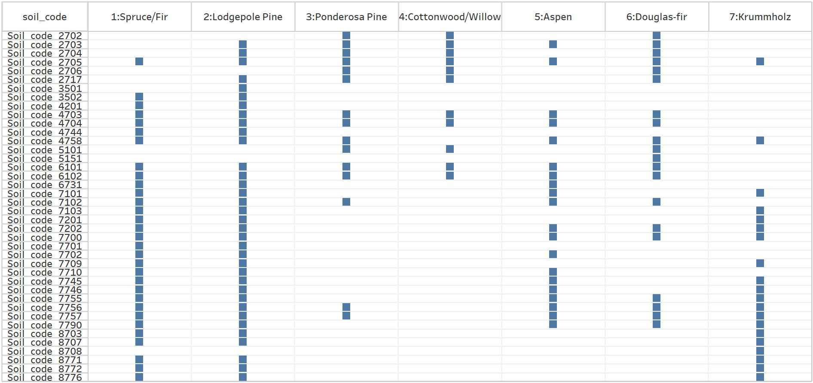
Visualization-Bivariate Analysis
Spruce and Lodgepole thrives in most of the soil types, where as cottonwood/Willow only grows in limited number of soils. Aspen grows in most of the soils yet there is only 1.5% of the Cover types.

Slide 16
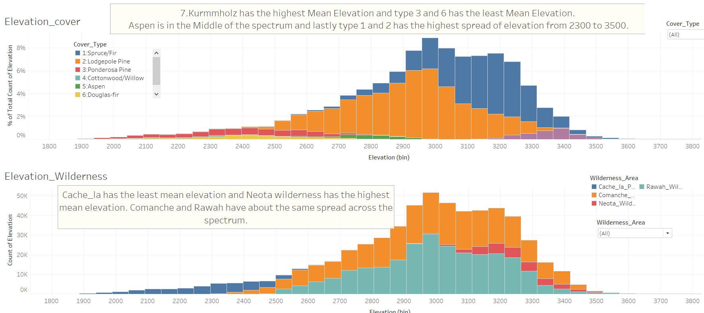
Visualization-Bivariate Analysis

Slide 17
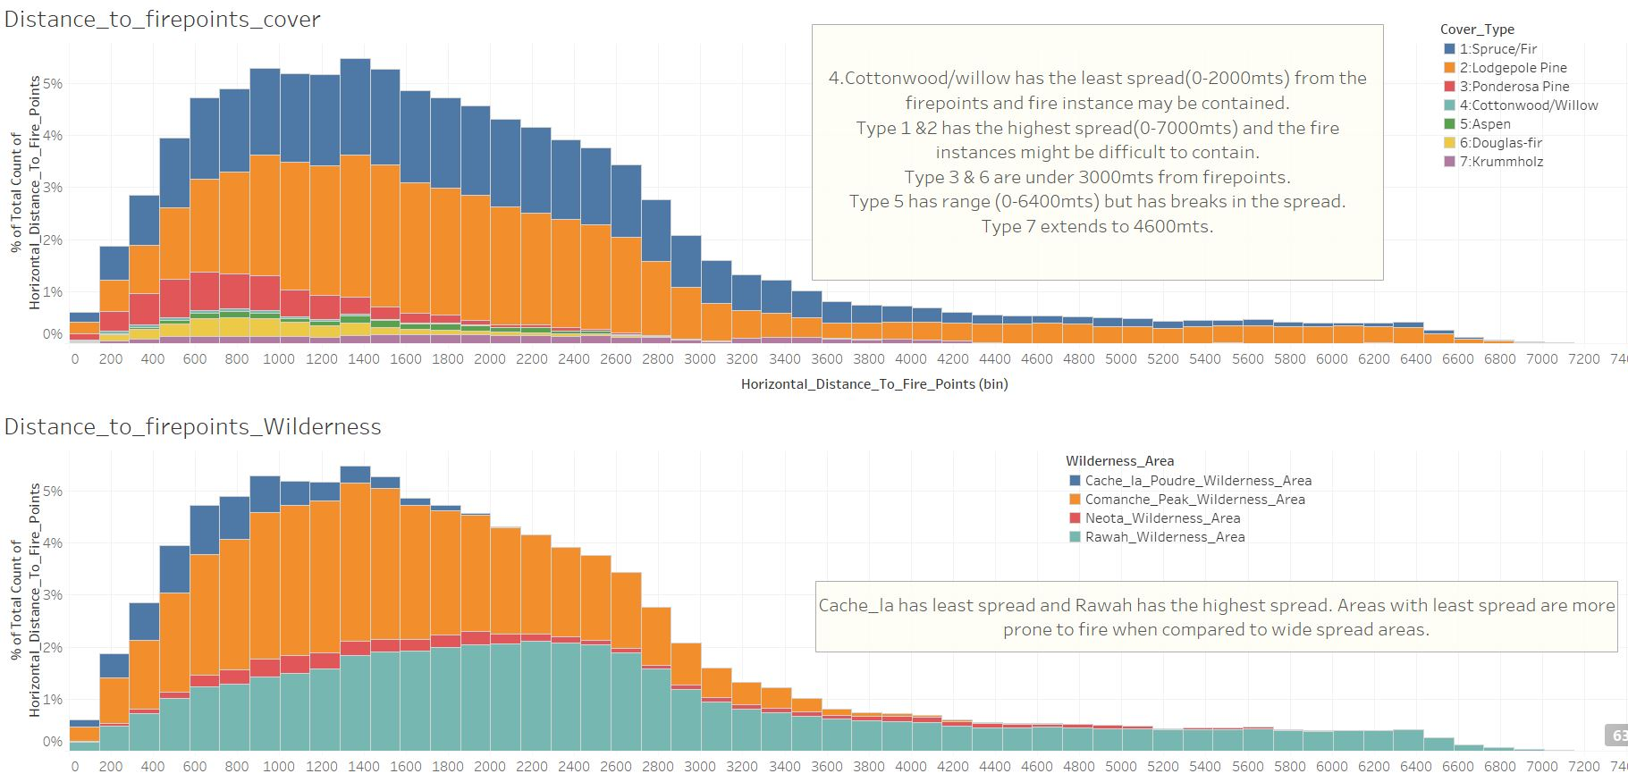
Visualization-Bivariate Analysis

Slide 18
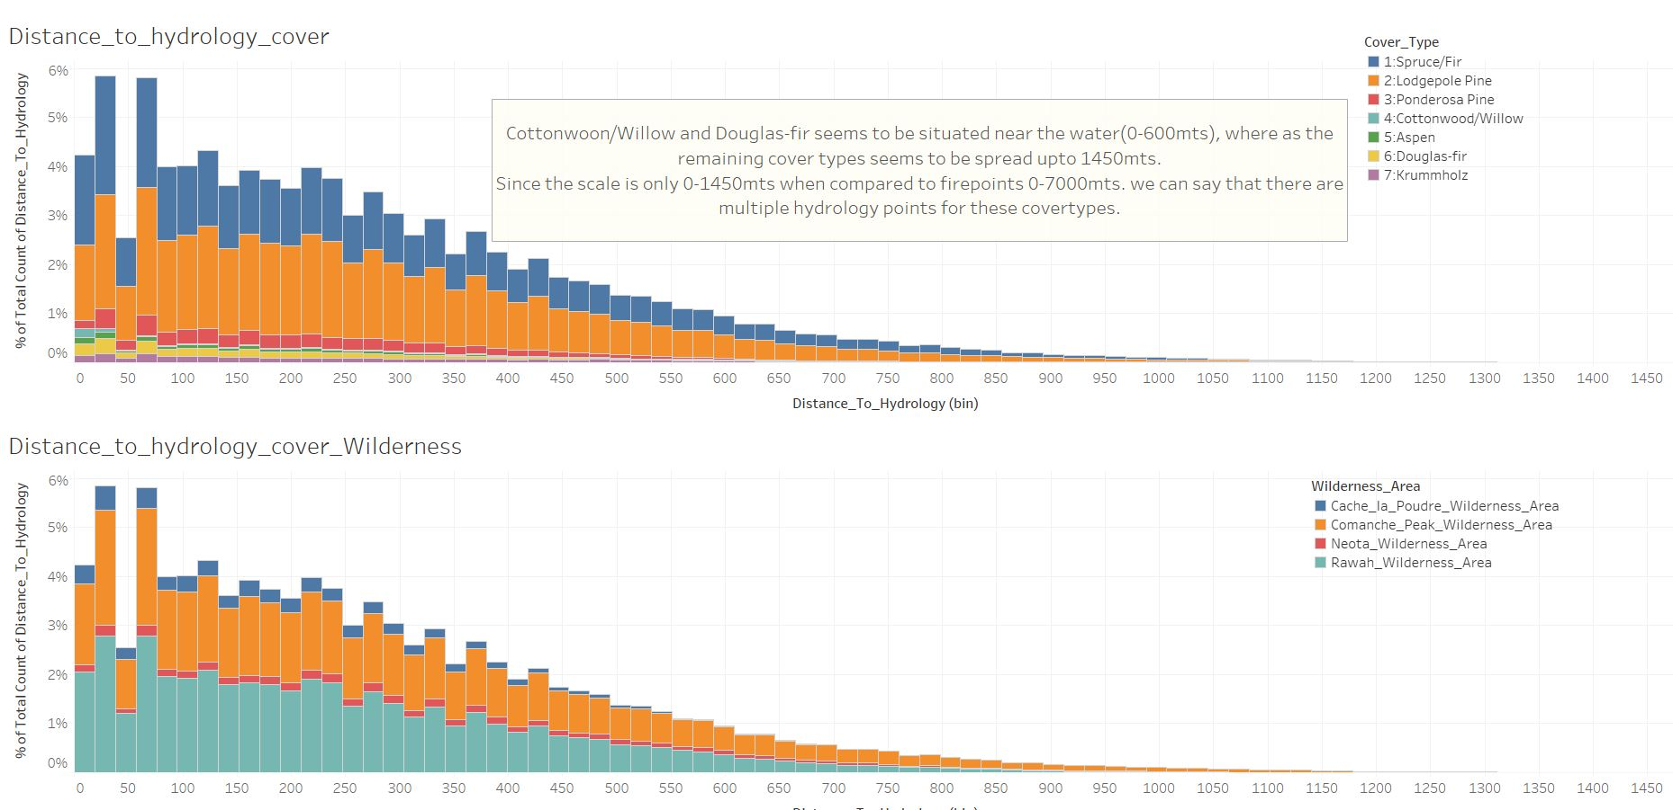
Visualization-Bivariate Analysis

Slide 19
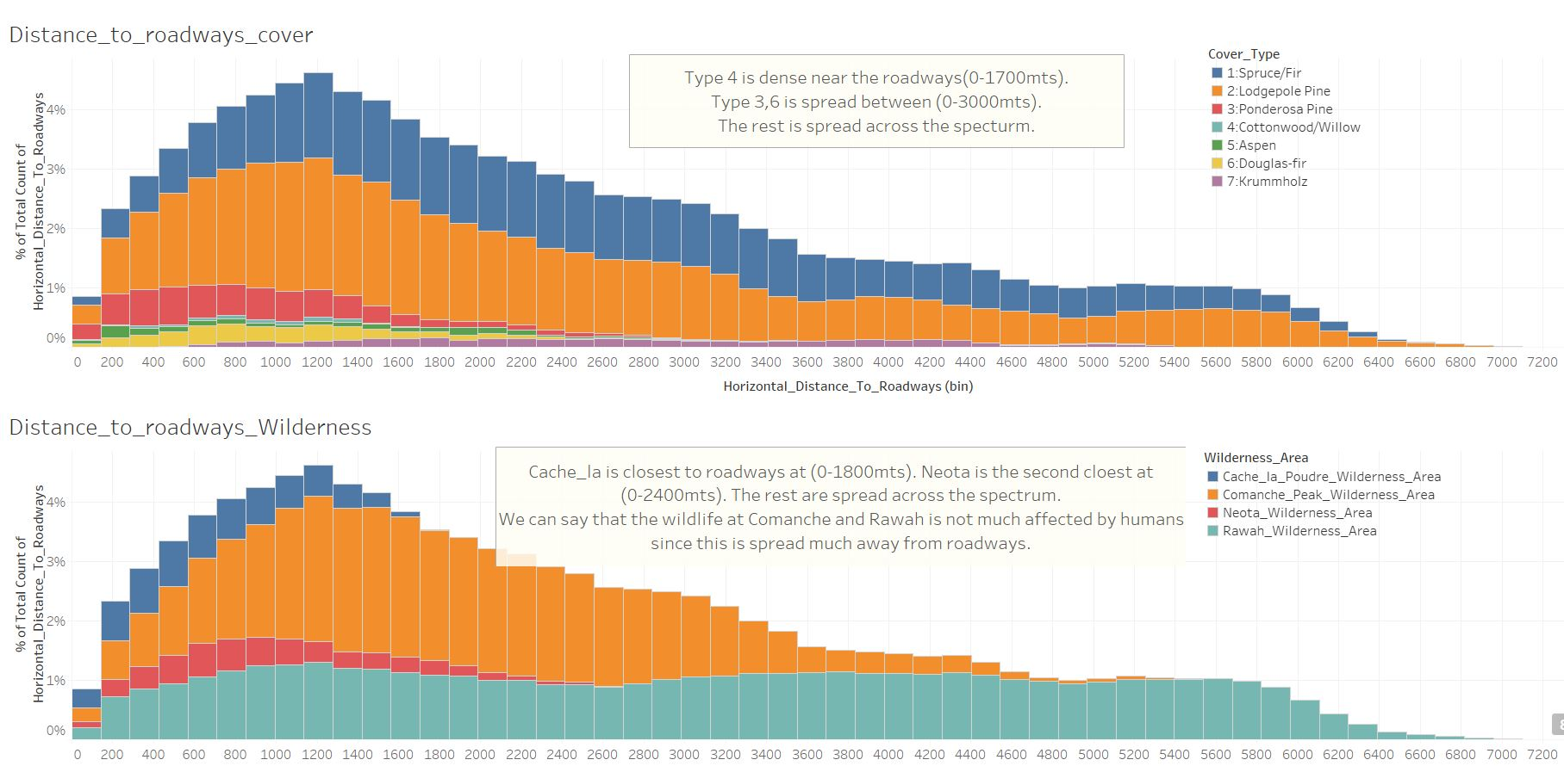
Visualization-Bivariate Analysis

Slide 20
Classification
One of the purposes of this project is to get the prediction for the various forest cover type and to build a model for the future prediction. After looking into the raw data we have adopted the following 4 approaches:
1.Forest Cover Soil Untreated - with outlier 2.Forest Cover Soil Treated - without Outliers
3. Forest Cover CG_Zone Untreated – With Outliers
4. Forest Cover CG_Zone_Treated – Without Outliers
Models Used:
Logistic Regression
Naive Bayes
Decision Tree
Random Forest
KNN

Slide 21
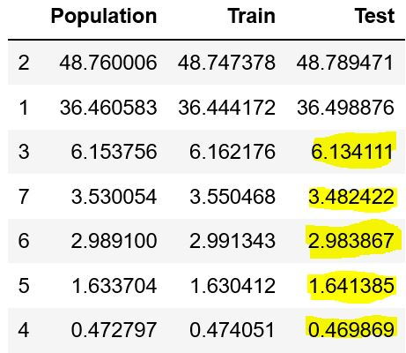
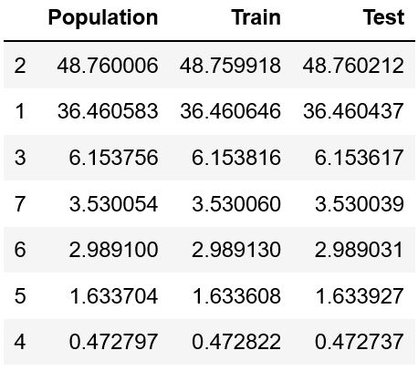
Steps for model building:
1. As per the approach, Train Test split (70:30) with Stratify as a parameter.
2. SMOTE for treating Imbalance
3. Random SearchCV with min 2 hyper parameters for all the models (Random State = 42).
4. Extracted the best Hyper-tuned model and rerun by removing features by using feature importance function.
5. Extracted the required features for model and Hyper-parameters.
Without Stratify
With Stratify

Slide 22
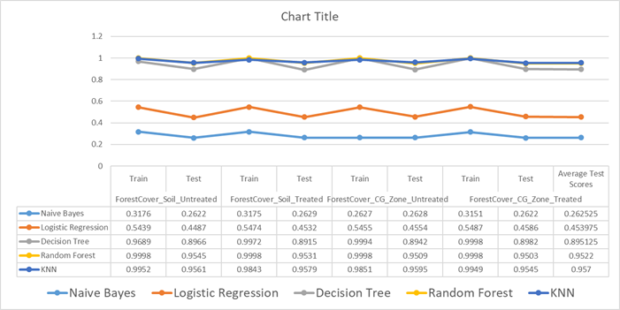
Models output after Hyperparameter tuning:
From the above graph we can see that the results of Random Forest and KNN are high and close, But based on the Consistent recall across train and test we select Random Forest as Best Model, Now we have to see the performance of Random forest to select the best approach.

Slide 23
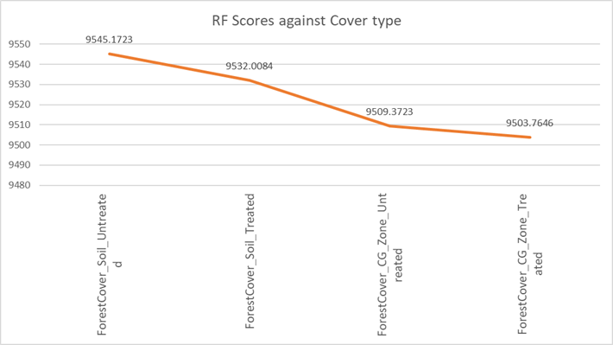
The best approach is the raw data with only Hill shade and Distance to Hydrology as synergised Columns and outliers are not treated for random forest. Now we have selected the best approach and model lets see metrics.

Slide 24
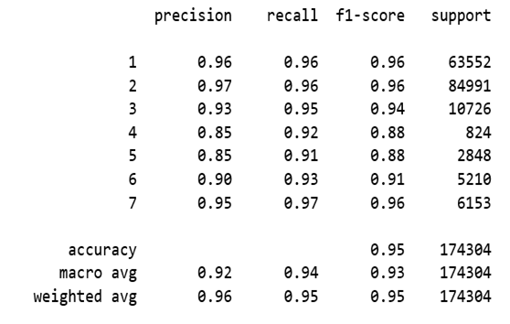
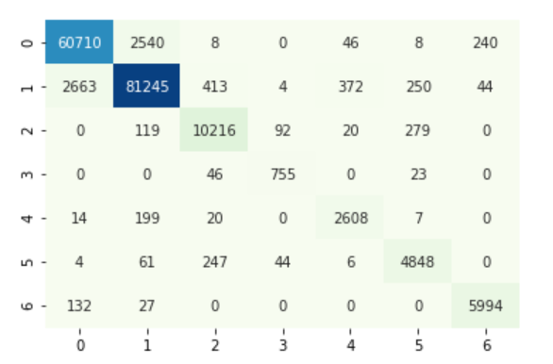
INFERENCE:
Final Model: Random Forest with Stratified Train test Split and used SMOTE for Imbalance Treatment.
Parameters: criterion='entropy',n_estimators=50,random_state=42, class_weight='balanced', max_depth=25
Required Features : 'Elevation', 'Aspect', 'Horizontal_Distance_To_Roadways', 'Horizontal_Distance_To_Fire_Points', 'Distance_To_Hydrology'
Metrics :
Train Recall : 0.9998
Test Recall : 0.9551
The f1_weighted of the Train is : 0.9998
The f1_weighted of the Test is : 0.9551

Slide 25
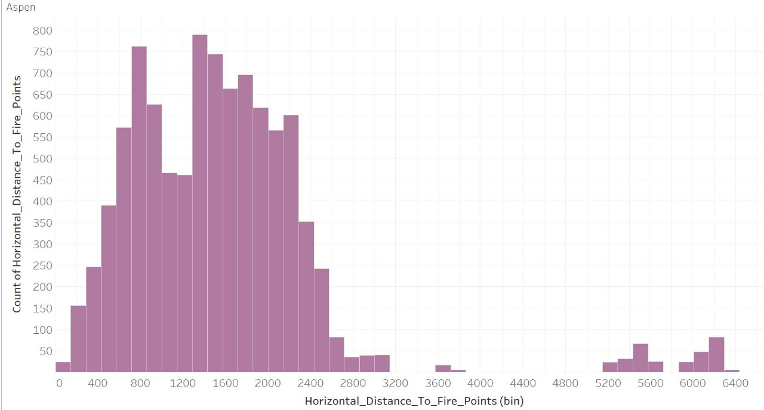
Recommendations
Since we have achieved the required business target to increase the efficiency from 70.58 and have achieved 95 %. We have some recommendations from EDA part as shown below
Only these 5 features are enough to predict the cover type using our model the features are 'Elevation', 'Aspect', 'Horizontal_Distance_To_Roadways', Horizontal_Distance_To_Fire_Points', 'Distance_To_Hydrology'.
There are missing values for Aspen in Distance to fire_points which may be investigated.

Slide 26
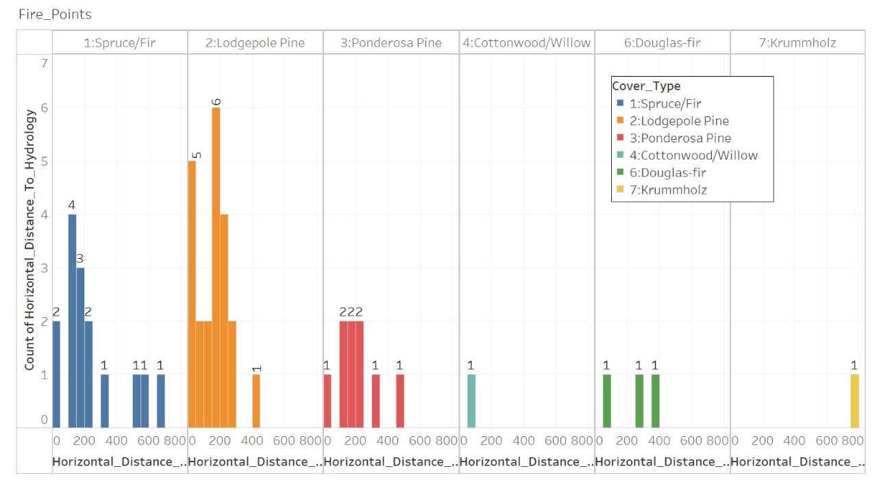
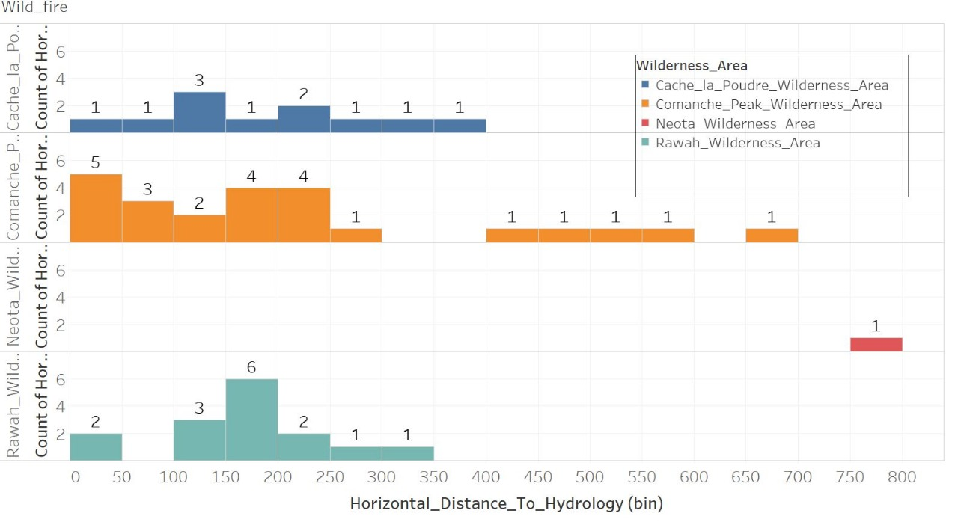
3. There are about 9 Fire points greater than 300 meters from Hydrology across cover types and Krummholz is the farthest at 800 mts which is located in Neota wilderness area.

Slide 27

Mentor: Mr. Ankush Bansal
Batch: DSE_BANGALORE_AUG2019
SUBMITTED BY:
AMULYA MANNE
APOORVA
GANESH DARSHAN
PRASHANTH G

